Slide 1
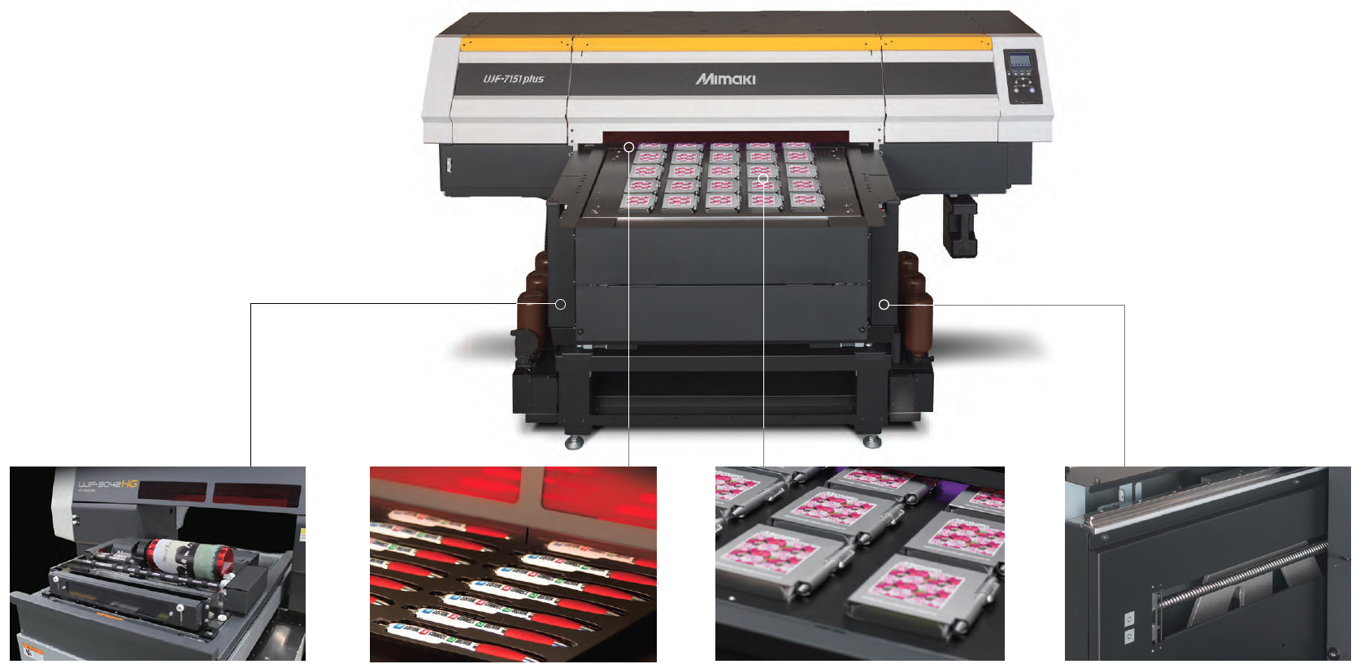
Printing Guide
UJF-7151plus
production flatbed LED UV printer
Date: 13-12-2018
Version: 1.1EU

Slide 2
Terms of use
The contents of this presentation are intended only for Mimaki authorized resellers. Authorized persons are not permitted to distribute, copy or change this presentation without explicit approval of Mimaki Europe B.V.
Contents and technical explanations in this presentation are based on the test results achieved at Mimaki at the time of testing and are not a guarantee for performance. Substrates should be tested beforehand.
In addition, the contents in this presentation do not lead to any legal obligations from Mimaki and Mimaki does not take any responsibility. Please verify in advance whether your intended prints will result in sufficient quality.
Contents of this presentation are subject to change without prior notice for improvement. Compositors errors reserved.

Slide 3
Available print modes
Print condition |  |  |  | Printing method
Print mode | Resolution | Pass | Print time （full size） | Color only | White only | Clear only | Primer only | Color + White | Color + Clear | Color + Primer
Undercoat^{*4} | 600x300 | 4pass | 3m47s | x ^{*1} | x ^{*1} | O^{*4} | O^{*4} | x ^{*1} | x ^{*1}) | x^{*1}
Draft | 600x600 | 6pass | 5m10s | O | O | x ^{*1} | △ ^{*2} | △ ^{*2} | x ^{*2} | △ ^{*2}
High speed |  | 8pass | 6m55s | O | O | △ ^{*3} | O | O | △ ^{*3} | O
 |  | 10pass | 8m30s | O | O | O | O | O | O | O
Standard | 600x900 | 12pass | 10m15s | O | O | △ ^{*3} | O | O | △ ^{*3} | O
 |  | 16pass | 13m50s | O | O | O | O | O | O | O
 | 1200x1200 | 12pass | 14m10s | O | O | O | O | O | O | O
High quality |  | 16pass | 18m40s | O | O | O | O | O | O | O
O：Available
△：Available, but not recommended
x：Not available
：Default print mode
Notes
*1 It causes print mode error on the printer.
*2 Adhesion of the media and ink may not be sufficient.
*3 Not recommended for solid clear since MAPS4 does not work.
*4 Recommended only for undercoat printing.
*5 Undercoat mode is available only when LUS-120 ink is installed.

Slide 4

MAPS
Use the MAPS* (Mimaki Advanced Pass System) function to disperse the pass boundary to make the feeding stripes less visible
MAPS4 can be switched to “AUTO” or “MANUAL” from printer’s operation panel:
  Press the “MENU” key in local mode
  With arrow keys select “SETTING”, then press ENTER
  Select “MAPS4”
  Select “AUTO” or “MANUAL”
AUTO | Uses the optimal gradation pattern depending on the print condition (Ink type, resolution, profile, etc..) By default, print with “AUTO” setting should be always used.
MANUAL | When there is a problem with the image quality with “AUTO” setting, adjust the gradation level of MAPS by changing the “smoothing level” in “MANUAL” setting.
* When printing clear ink, MAPS4 does not work in 600x600dpi 8pass and 600x900dpi 12pass modes.

Slide 5
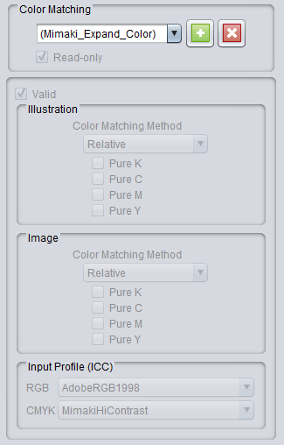

Color matching function
Standard RasterLink6plus setting for printing with MkII series is set to “Mimaki Expand Color”
Setting conditions are:
  Illustration→Color Matching Method: Relative
  Image→Color matching Method: Relative
  Input profile(ICC)
    RGB：AdobeRGB1998
    CMYK：MimakiHiContrast*
When printing thin lines or small fonts:
  It is recommended to enable “Pure K” for both
  Illustration and Image on the color matching setting
To create new color matching setting:
  RasterLink6→ Print Condition → Color Matching
  Highlight and delete “Mimaki Expand Color” in Color Matching Window and input new name
  Click on and change the setting
  New setting will be active
*MimakiHiContrast works only with device profiles v3.5 or higher.

Slide 6
Printing clear ink
For printing clear use print modes above 600x600dpi 8pass
Use recommended ink density settings for printing clear depending on the substrate and the resolution
Clear printings will have a better quality by using the optimum density depending on the print condition
Purpose |  | Print condition |  | Glossy finish |  |  |  |  | Matte finish | Profile
Normal printing | Undercoat printing | Resolution | Pass | FOREX | White PET | Lexan | Acrylics | Coated boards | Any media type
x | O | 600x300 | 4pass | x^{*1} | x^{*1} | x^{*1} | x^{*1} | x^{*1} | 70% | For printing undercoat clear*²
O | O | 600x600 | 8pass | 100% | 80% | 80% | 80% | 100% | 60% | For printing color
 |  |  | 10pass | 100% | 100% | 100% | 100% | 100% | 60%
O | O | 600x900 | 12pass | 80% | 80% | 80% | 80% | 80% | 60%
 |  |  | 16pass | 100% | 100% | 100% | 100% | 100% | 60%
O | O | 1200x1200 | 12pass | 100% | 100% | 100% | 100% | 100% | 70%
 |  |  | 16pass | 100% | 100% | 100% | 100% | 100% | 70%
O：Available
△：Available, but not recommended
x：Not available
Notice on glossy clear print:
If the density of clear ink is too high, regularly spaced stripes may appear on the printed surface.
Please lower clear density.
Notice on matte clear print
If the density of clear ink is too, high irregular stripes or gloss may occur.
Please print with lower density.
*1 It causes the print mode error on the printer.
*2 Undercoat mode is available only when LUS-120 ink is installed.

Slide 7
Printing primer ink
When printing with 600x600dpi 6pass, the adhesion between ink and media may not be sufficient.
  Please use print modes above 600x600dpi 8pass
It is recommended to print Primer with 100% density from RasterLink6
  This setting will automatically adjust the density to the recommended print density
  If density is set to other value than 100%, the recommended print density will change
    E.g. setting “Primer” to 50% at 600x600dpi will set the recommended print density to 25%
Recommended settings for 3rd party RIP
or resolution other than 600x600:
Printing with other than recommended density might cause the following issues
Primer density is set too high:
  Hardness of the primer layer may decline
  The primer layer might be scratched off
  The primer layer might break when it is exposed to temperature
Primer density is set too low
  Adhesion might become weak.
  The primer layer might break when it is exposed to temperature
Resolution | Recommended density
 | Combination with LH-100 | Combination with LUS-120
600x300 | x^{*1} | 70%
600x600 | 50% | 40%
600x900 | 40% | 30%
1200x1200 | 20% | 20%
*1 It causes the print mode error on the printer.

Slide 8

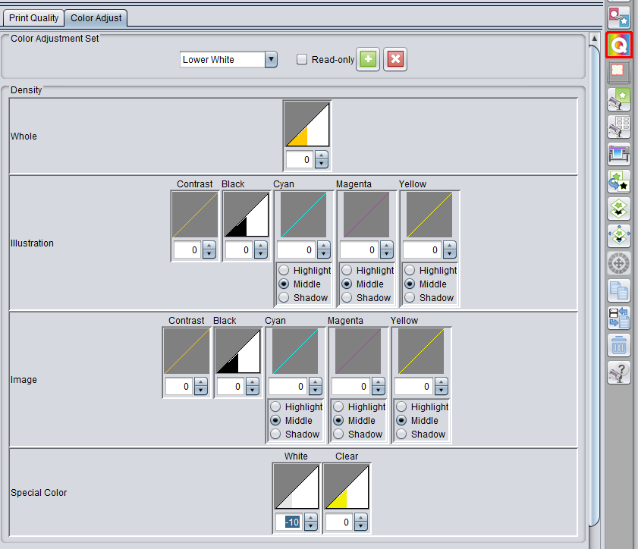
Printing white ink
A Higher density white ink is available for following print modes:
Print conditions |  |  |  | High density printing
Print mode | Resolution | Pass | Print time （full table） | High density white | MAPS4 availability when printing high density white | Recommended density
Standard | 600x900 | 12pass | 10m15s | O | x ^{*1} | 10 - 90% (*2)
 |  | 16pass | 13m50s | O | O | All density
*1 MAPS4 is not available with 600x900 12pass high-density mode. It may cause banding and uneven color.
*2 Adhesion of the media and ink may not be sufficient when the density of white is higher than 90%.
To activate higher density white print:
  RasterLink6→Print Condition
  Choose Tab “Print Quality”
  Check option “Printing of the White-ink at higher density”
2
1
Example to lower the white ink density
  RasterLink6→Print Condition
  Choose Tab “Color Adjust”
  Input optional name and click to
  In Density→Special Color→White lower the value
    E.g. setting to -10% will set the
    white print density to 90%
3
4

Slide 9
Undercoat printing
When printing directly on general acrylic substrates, Acrylite, Sumipex or Plexiglas with LUS-120, the image quality may gets blurred
By printing undercoat*¹ with “primer” or “clear”, thin lines and small fonts can be printed sharp without being blurry
Comparison:
Print speeds for undercoat print in standard mode
*1 Refer to recommended density setting of clear and primer for undercoat printing
Print data | LUS-120 w/o undercoat | LUS-120 w/ undercoat | LH-100 (Standard)
Lines & fonts | x | ◎ | ●
Pictures | ● | O | ●
Image quality
◎ - Very good
O - Good
● - Standard
x - Not good
Print mode |  | LUS-120 with primer
 |  | Speed[㎡/h] | Print time per table
Draft | 600x600, 6p, Uni, Hi | 2.43 | 8m57s
High speed | 600x600, 8p, Uni, Hi | 2.04 | 10m42s
Standard | 600x900, 12p, Uni, Hi | 1.52 | 14m22s
High quality | 1200x1200, 16p, Uni, Hi | 0.97 | 22m27s

Slide 10
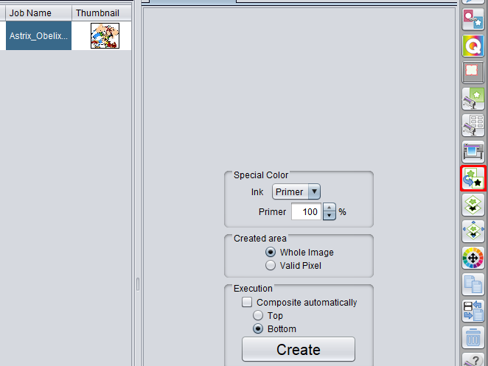
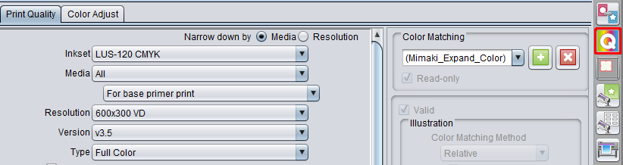
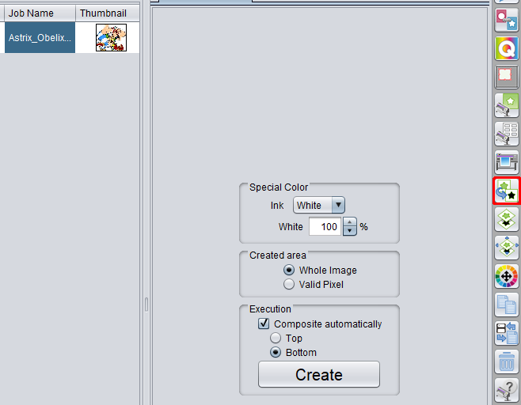
Setting undercoat printing: primer
Create “Primer” layer by clicking on Color layer and then “Special Plate”
  Set the Special Color condition
    Ink: Primer
    Primer: 100%
    Created Area: choose one of options
    Click on Create
  Set print condition for Special Plate
    Select created Special Plate
      Click to Print Condition Tab
      Set Media: For base primer print
      Resolution: 600x300dpi
      Pass: 4
Create “Color + White” by clicking on Color layer and then “Special Plate”
  Set the Special Color condition
    Ink: White
    White: Set optional density
    Created Area: choose one of options
    Check “Composite automatically”
    Click on Create
Print “Primer” and then “Color +White” Plate
I
1
II
III
IV
I
2
II
III
IV
V

Slide 11
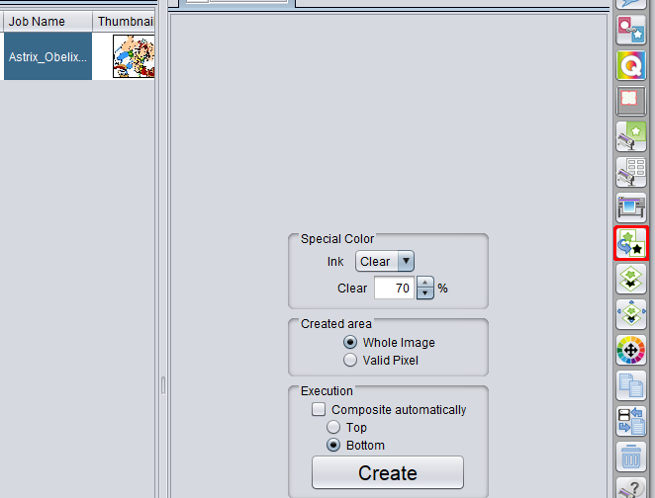
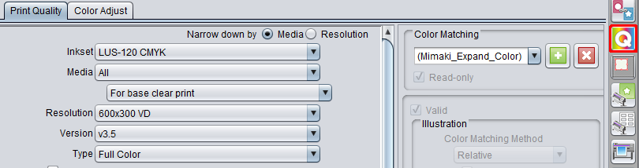
Setting undercoat printing: Clear
Create “Clear” layer by clicking on Color layer and then “Special Plate”
  Set the Special Color condition
    Ink: Clear
    Clear: 70%
    Created Area: choose one of options
    Click on Create
  Set print condition for Special Plate
    Select created Special Plate
      Click to Print Condition Tab
      Set Media: For base clear print
      Resolution: 600x300dpi
      Pass: 4
Create “Color + White” by clicking on Color layer and then “Special Plate”
  Set the Special Color condition
    Ink: White
    White: Set optional density
    Created Area: choose one of options
    Check “Composite automatically”
    Click on Create
Print “Clear” and then “Color +White” layer
I
1
II
III
IV
I
2
II
III
IV
V

Slide 12
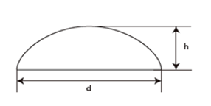
Braille printing: General
Braille characters shape according to JIS* (Japanese Industrial Standard) can be can be easily created in in Adobe Illustrator by setting a spot color around Braille characters with RasterLink Tools
Requirements:
Measurement range | Minimum size
d= dot base diameter | 1,46mm +/- 0,05
h= dot height | 0,4mm +/- 0,1
Printer | UJF-3042MkII, UJF-6042MkII, UJF-7151
Ink | LH-100 (Clear and Primer PR-200)
Software | RasterLink6Plus ver. 1.4~ RasterLink Tools for Illustrator ver. 1.5.2~
*Current version of RasterLink6Plus v1.4 supports only Braille JIS standard

Slide 13
Braille Printing: procedure
1. Illustrator
Braille file preparation in Adobe Illustrator
2. RasterLink Tools
3. RasterLink Tools
4. RasterLink6Plus
5. RasterLink6Plus
Exporting the Braille signs to RasterLink6Plus
Import Braille data into rasterLink6Plus and set printing condition
Print the Braille data
Set Spot Color around Braille signs in Illustrator

Slide 14
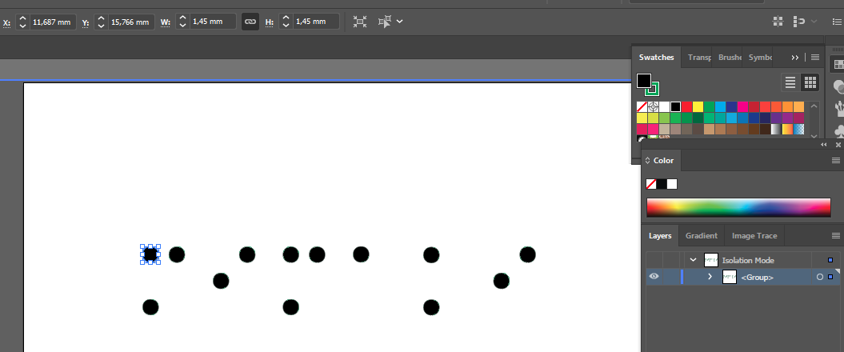
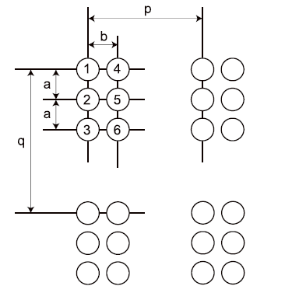
Braille printing: Design
Create vector data for Braille characters
  Shape: Circle
  Diameter: 1,45mm
Dimensions of JIS Braille sizes:
Measurement range | Measurement size
a: Vertical dot-to-dot | 2,3mm +/- 0,1
b: Horizontal dot-to-dot | 2,3mm +/- 0,1
q: Vertical cell-to-cell | 6,1mm +/- 0,1
p: Horizontal cell-to-cell | 5,0mm

Slide 15
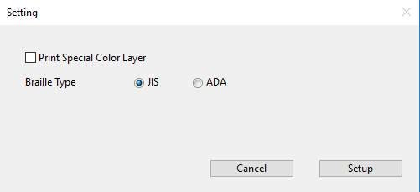
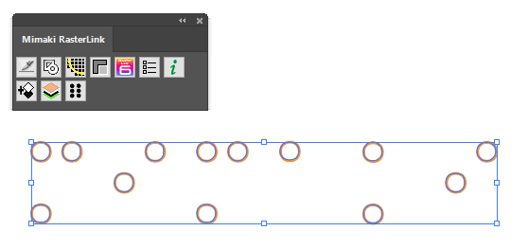

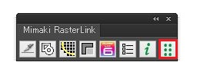
Braille printing: Design
Confirm RasterLink Tools setting :
  Set the Braille type to “JIS”
  Check off the option “Print Special Color Layer”
Set a spot color around Braille data by RasterLink Tools
  Select Braille data
  Press the “Braille” icon in RasterLink Tools
  The Braille spot color “MmkBraille_ADA” or “MmkBraille_JIS”
  will be created around characters with following specification:
    Stroke thickness: 0,5pt
    Fill: none
Save the Braille job for RasterLink6Plus via Rasterlink Tools
  Press the “RasterLink6” icon in RasterLink Tools
  Save the file as EPS

Slide 16
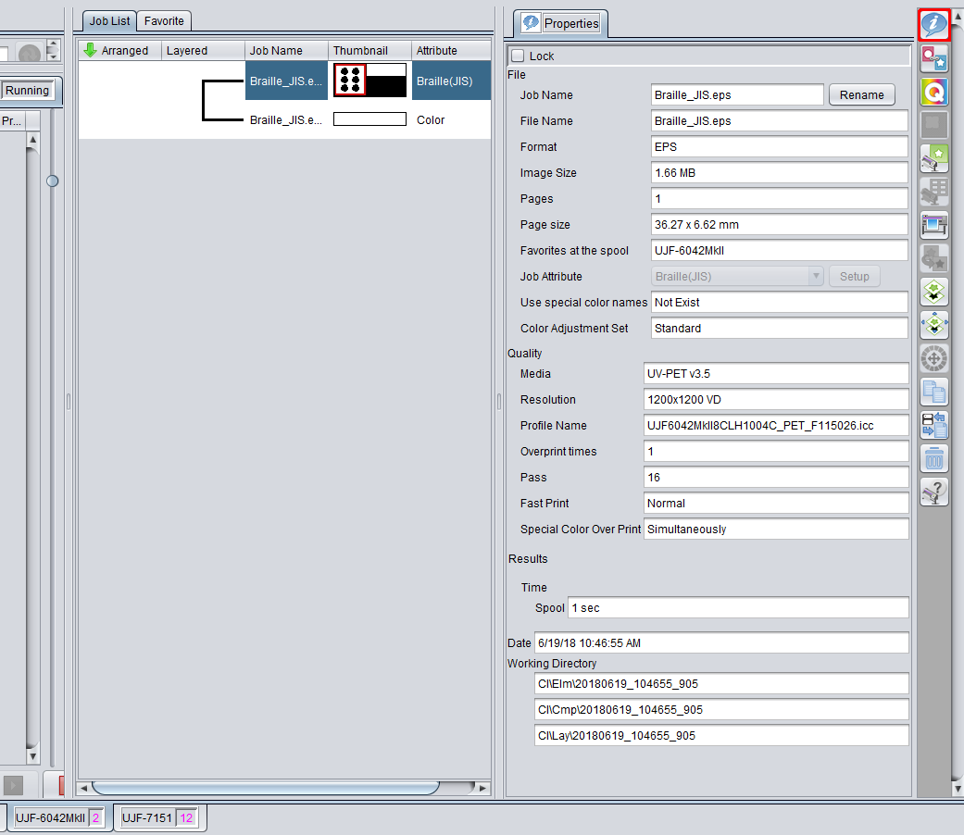

Braille printing: print
Braille printing requires that the specific profile is installed in RasterLink6Plus
Import Braille job into RasterLink6Plus
Click on icon for Print Execution
Click “Start” button to print Braille job
Printer | Ink set | Output setting | Profile | Material
UJF-7151plus | LH-100 CMYK | 600x900dpi | UV-PET | Glossy white PET
UJF-3042MkII | LH-100 CMYK | 1200x1200dpi* | UV-PET v3.5
UJF-3042MkIIEX/ UJF-6042MkII | LH-100 CMYKLcLm | 1200x1200dpi* | UV-PET v3.5
* MkII Series will print the final top layer with glossy clear at 600x600 10-pass

Slide 17
Metallic InK: Print Workflow
1. Import Data
Import “Color” and “Metallic Color” data
2. Create Metallic Layer
3. Composite Layers
4. Finish Metallic Layer
5. Set Quality
Composite all layers into one job
Set finish condition for Metallic Layer
Set printing conditions for Composited Job
Create “Metallic” layer from “Metallic Color” data
6. Print
Execute printing operation

Slide 18



INtroduction
The MUH-100 metallic in RasterLink6 can be printed by arranging the print data in 3 layers
Each layer is printed separately
3. Metallic Color Layer
Color ink over metallic ink
Top Layer
2. Color Layer
Color ink
Middle Layer
1. Metallic layer
Metallic ink
Bottom Layer
1st feed
  Metallic Layer
2nd feed
  Color Layer
3rd feed
  Metallic Color Layer

Slide 19
MUH-100-SI Print COndition
Compatible Printer
Print Condition
Printer | Ink-set | Special ink-set
UJF-7151 | LH-100 CMYK | WSi
 |  | CSi
Type | Resolution | Pass | Color-matching | Job Attribute | Note
Metallic layer | Hi 600x900 VD Si | 20 | Optional | Silver | High speed
 | Std 600x900 VD Si |  |  |  | High quality
Metallic Color Layer | 600x900 VD Silver Color | 16 | ColorMatching OFF | Color

Slide 20

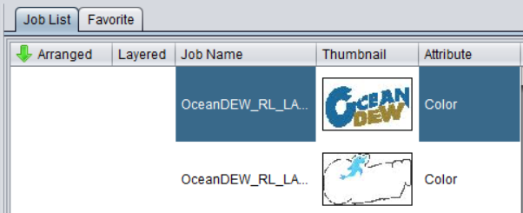
Import Data
Import to RasterLink 6 Plus the print data for “Color” and “Metallic Color” layers
The “Color” and “Metalic Color” layers are displayed in [Job List] of RasterLink 6 Plus
1. Metallic Color Layer
Color ink over metallic ink
2. Color Layer
Color ink

Slide 21

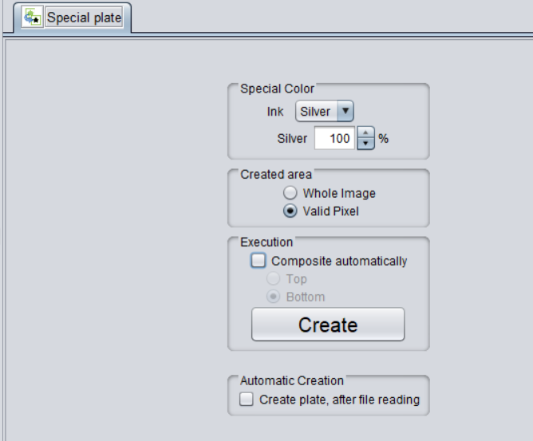
Create Metallic Layer
Select “Metallic Color” layer and click the [Special plate] icon from Toolbar
On the [Special plate] window, specify "Silver" for ink, "Valid pixel" for created area, and then click the [Create] button
The “Metallic” layer job is now created
1.Select ”Silver” for Ink
2.Select "Valid pixel“
for created area
3.Click the [Create] button

Slide 22
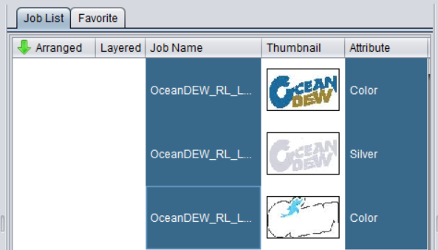

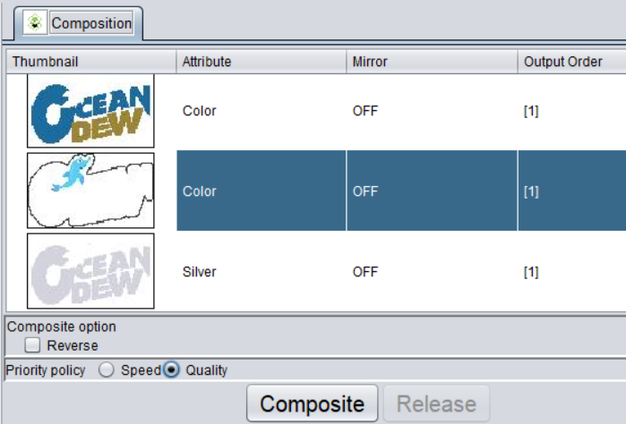
Composite Layers
Select three jobs from the [Job List] : “Metallic Color”, “Color”, and “Silver” layers
Click on [Composition] icon from Toolbar
On Composition window confirm:
  Layer order from top: “Metallic Color”, “Color”, “Silver”
Select [Quality] as the Priority Policy
Click on [Composite] button
Metallic Color
Color
Silver

Slide 23
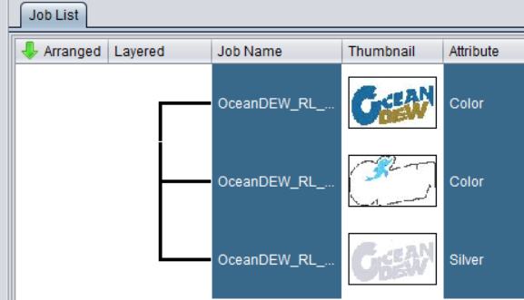
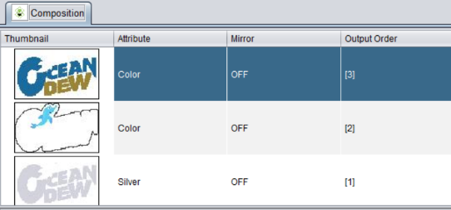
Composition Confirmation
The selected jobs in the job list are composed and a line is displayed in [Layered]
Composed jobs output order:
  “Metallic Color” -3 (Top layer)
  “Color” -2 (Middle layer)
  “Silver” -1 (Bottom Layer)

Slide 24
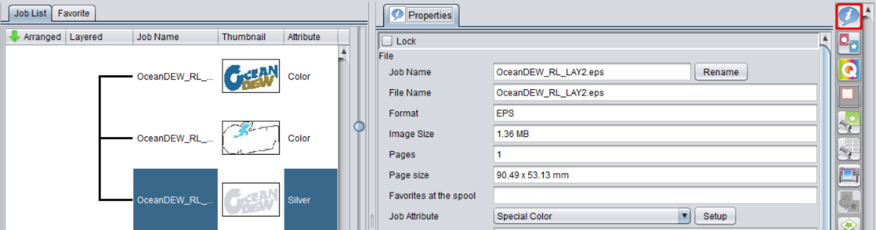
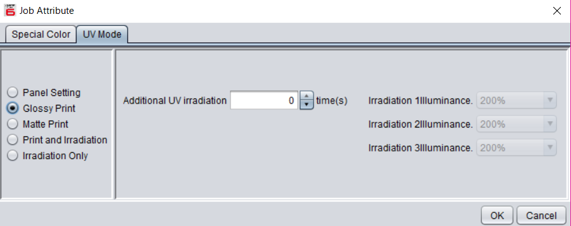
Finish Of Metallic Layer
Click on [Properties] Icon from Toolbar
Select the “Silver” layer from [Job List”
Click the [Setup] button in “Job Attribute” on [Properties] window
Select "Glossy Print" or "Matte Print“ on the [UV Mode] tab
  Glossy Print will create mirrored shiny effect
  Matte Print will create matte smooth effect
1. Select [Properties]
2. Select silver plate
3. Click [Setup]

Slide 25

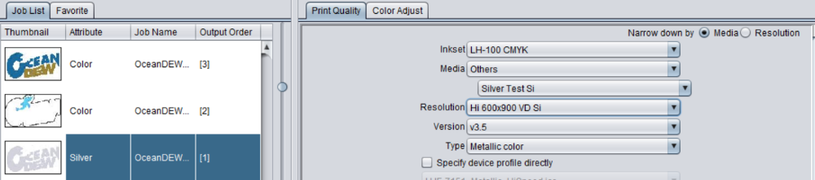
Set Print Quality of Metallic Layer
Click the [Quality] icon from Toolbar
Select ‘Silver” Job from [Job List]
Setup [Print Quality] Tab as follows:
  “Media”: Select media that ends with “Si”
  “Resolution”: Select “Std 600x900 VD Si”
1. Select “Silver” job
2. Select the media name
that ends with "Si"
3. Select STD quality for the Resolution

Slide 26
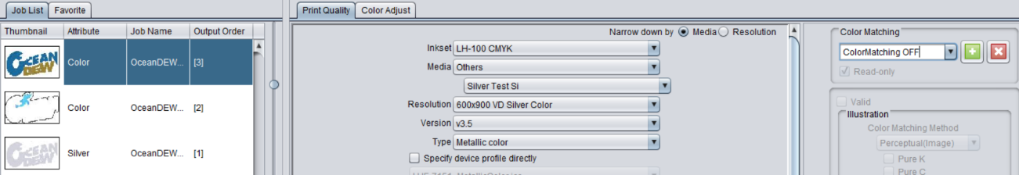
Set Print Quality of Metallic Color
Click the [Quality] icon from Toolbar
Select ‘Metallic Color” Job from [Job List]
Setup [Print Quality] Tab as follows:
  “Media”: Select media that ends with “Si”
  “Resolution”: Select “Std 600x900 VD Silver Color”
  “Color Matching”: Select “ColorMatching OFF”
4. Select
“ColorMatching OFF”
1. Select
“Metallic Color” job
2. Select the media name
that ends with "Si"
3. Select
"600x900 VD Silver Color"

Slide 27
Set Print Quality of Color
Click the [Quality] icon from Toolbar
Select ‘Color” Job from [Job List]
Setup [Print Quality] Tab as follows:
  “Media”: Select media that is used for printing
  “Resolution”: Select available resolution
Color
OceanDew..
[3].
Color
OceanDew..
[3].
1. Select
“Color” job
2. Select the media name
that is used for printing
3. Select
resolution

Slide 28

Print Metallic Job Composition
Click the [Execution] icon from Toolbar

Slide 29
Revision History
Version | Date | Content | Drafter
1.0EU | 16-06-2018 | 1st release | Product Management EMEA
1.1EU | 13-12-2018 | P16: Braille printing function is available in UJF-3042MkII EX P17: Added Metallic Ink Print Guide | Product Management EMEA

Slide 30
Thank you

